Slide 1
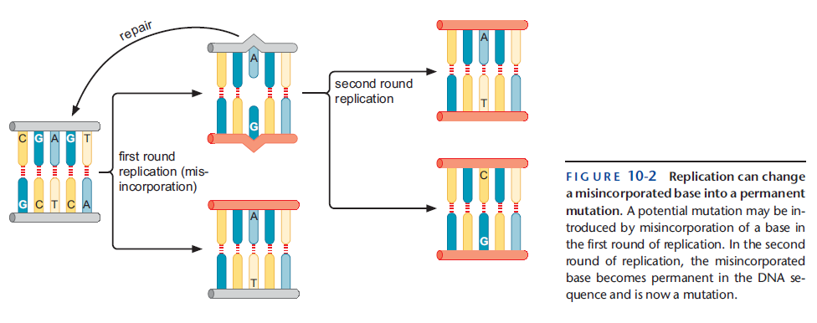
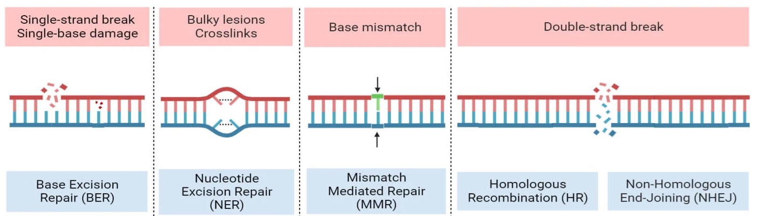
DNA damage vs DNA mutation
Lecture - 13

Slide 2
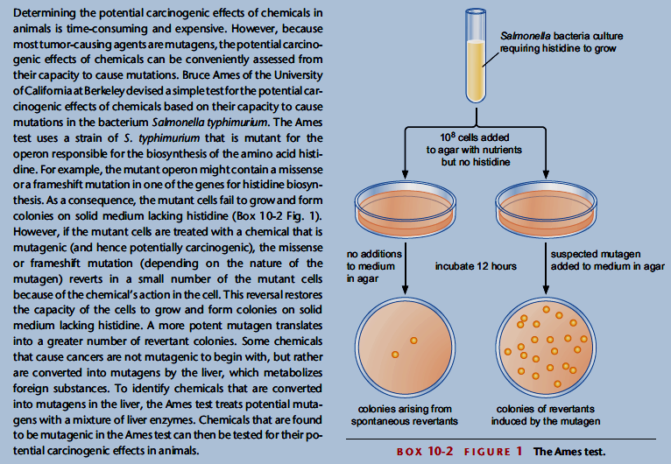
Chemical mutagens: Ames Test

Slide 3
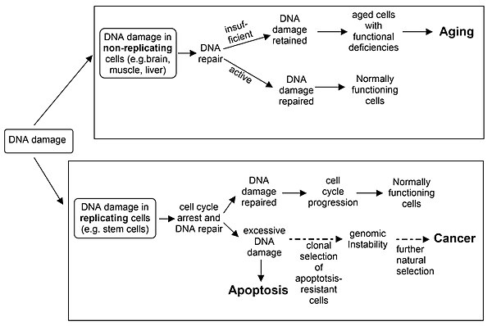
Consequences of DNA damage/mutation

Slide 4
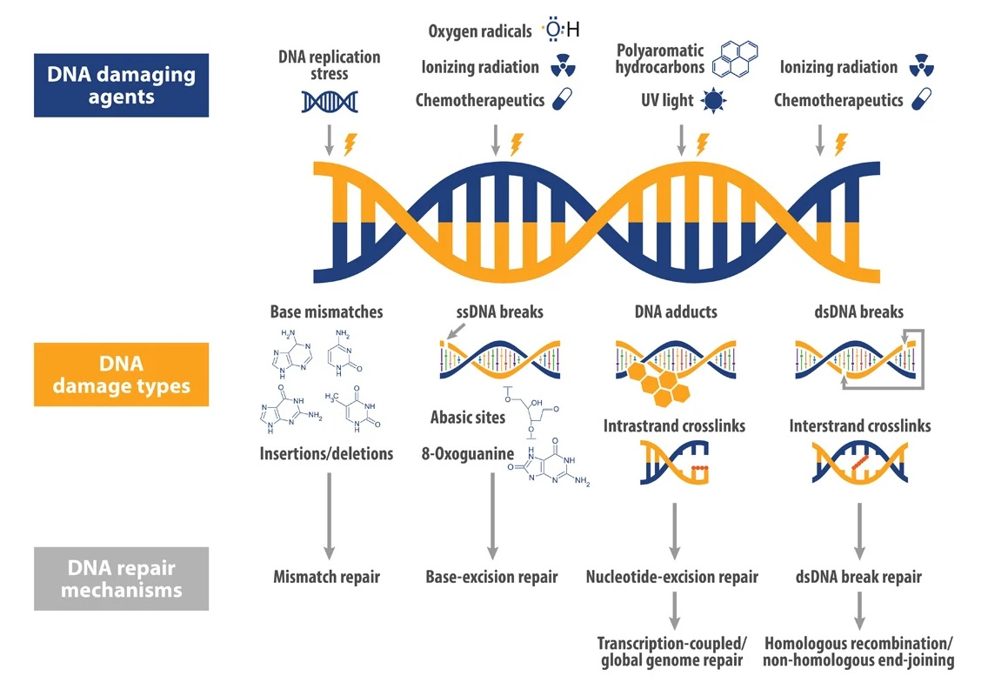
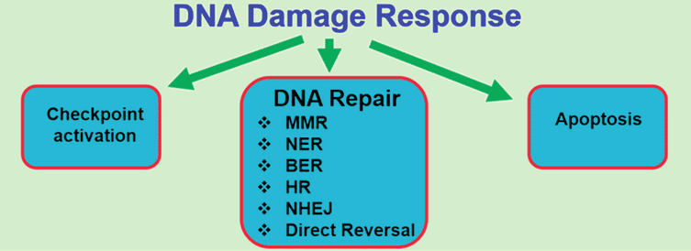
DNA damage and response
Notes:
It is important to distinguish between DNA damage and mutation, the two major types of error in DNA. DNA damage and mutation are fundamentally different. Damage results in physical abnormalities in the DNA, such as single- and double-strand breaks, 8-hydroxydeoxyguanosine residues, and polycyclic aromatic hydrocarbon adducts. DNA damage can be recognized by enzymes, and thus can be correctly repaired if redundant information, such as the undamaged sequence in the complementary DNA strand or in a homologous chromosome, is available for copying. If a cell retains DNA damage, transcription of a gene can be prevented, and thus translation into a protein will also be blocked. Replication may also be blocked or the cell may die.
In contrast to DNA damage, a mutation is a change in the base sequence of the DNA. A mutation cannot be recognized by enzymes once the base change is present in both DNA strands, and thus a mutation cannot be repaired. At the cellular level, mutations can cause alterations in protein function and regulation. Mutations are replicated when the cell replicates. In a population of cells, mutant cells will increase or decrease in frequency according to the effects of the mutation on the ability of the cell to survive and reproduce.
Although distinctly different from each other, DNA damage and mutation are related because DNA damage often causes errors of DNA synthesis during replication or repair; these errors are a major source of mutation.

Slide 5
Notes:
global genomic NER (GG-NER) and transcription coupled NER (TC-NER)

Slide 6
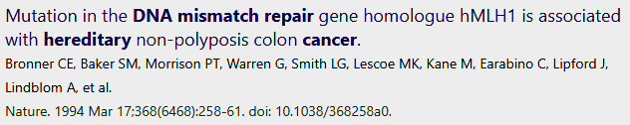
DNA mismatch repair
Despite extraordinary fidelity of DNA synthesis, errors do persist
Such errors can be detected and repaired by the post-replication mismatch repair system
Prokaryotes and eukaryotes use a similar mechanism with common structural features
Defects in mismatch repair elevate spontaneous mutation rates 10-1000x
Defects in mismatch repair underlie human predisposition to colon and various other cancers
Lynch syndrome
Notes:
Depurination is a chemical reaction of purine deoxyribonucleosides, deoxyadenosine and deoxyguanosine, and ribonucleosides, adenosine or guanosine, in which the β-N-glycosidic bond is hydrolytically cleaved releasing a nucleic base, adenine or guanine, respectively.

Slide 7
and ligase
Notes:
MutS associates with DNA replication forks and likely scans newly synthesized DNA

Slide 8
But how does the E. coli mismatch repair system know which of the two mismatched nucleotides to replace?
The E. coli enzyme Dammethylase methylates A residues on both strands of the sequence 5’-GATC-3’. The GATC sequence is widely distributed along the entire genome
Notes:
The strand discrimination mechanism has not been worked out for most bacteria or eukaryotes, but is well understood for E. coli and some closely related bacteria.
Thus, for a few minutes, until
theDammethylase catches up and methylates the newly synthesized strand,
daughterDNA duplexes will be methylated only on the strand that served as
a template (Fig. 10-5a). Thus, the newly synthesized strand is marked (it
lacks a methyl group) and hence can be recognized as the strand for repair.

Slide 9
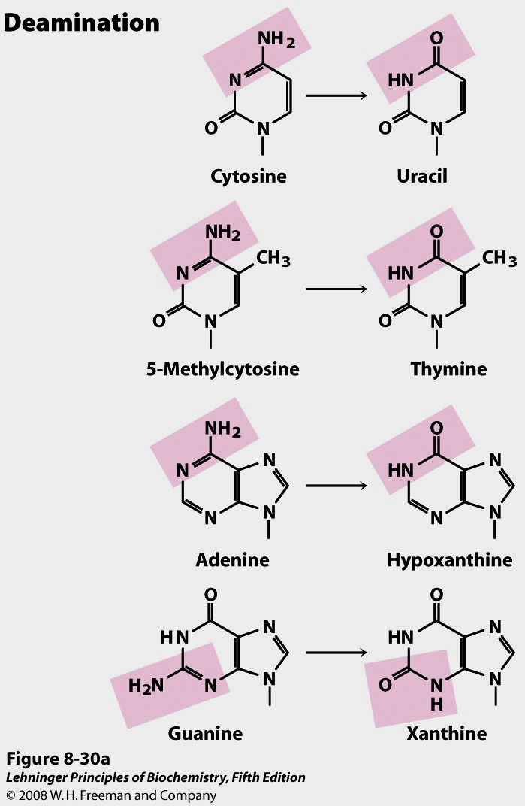
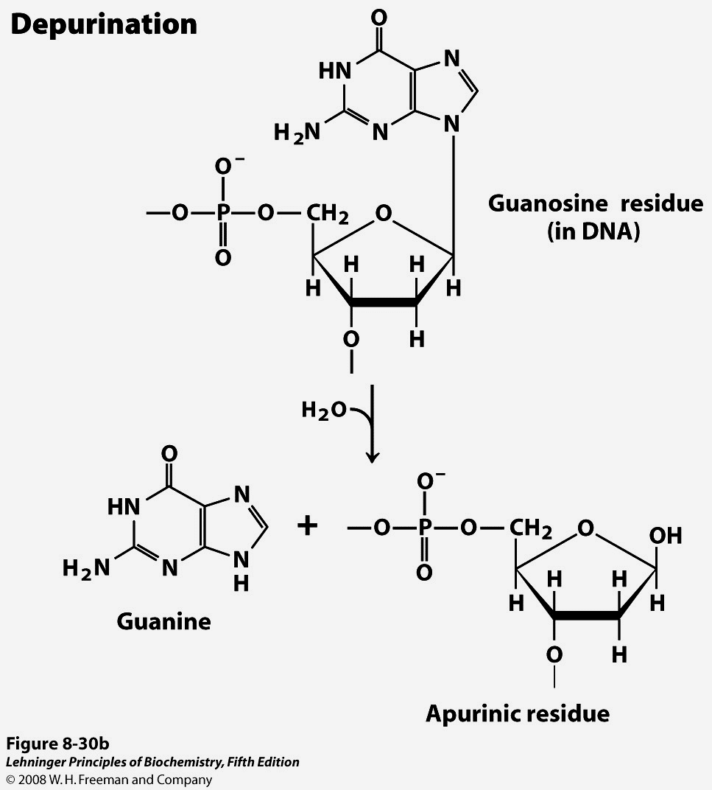
Base excision repair (BER)
The base excision repair machinery protects DNA from the damaging effects of oxidation, alkylation, deamination and depurination. It is specialized to fix single base damage in the form of small chemical modifications.

Slide 10
Tomas Lindahl, Nobel Lecture

Slide 12
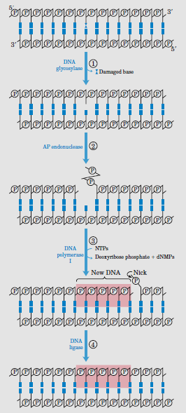
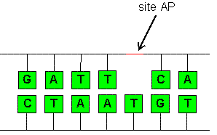
General mechanism of BER
Notes:
In addition to the polymerase activity, there is a 3′–5′ exonuclease that serves to proofread polymerase errors, and a structure-specific 5′ nuclease capable of removing a DNA strand ahead of the site of polymerase addition during synthesis on double-stranded DNA.
an AP site (apurinic/apyrimidinic site), also known as an abasic site, is a location in DNA

Slide 13
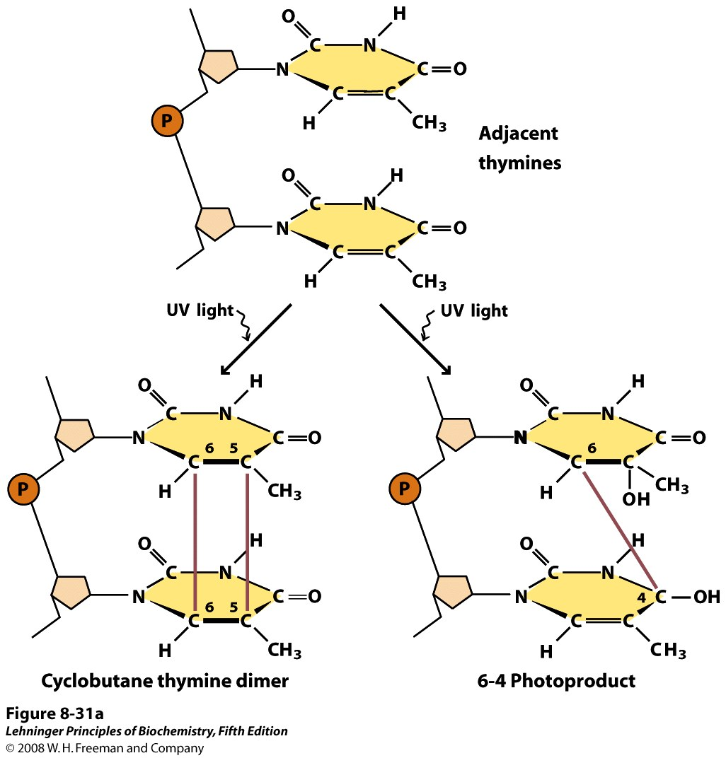
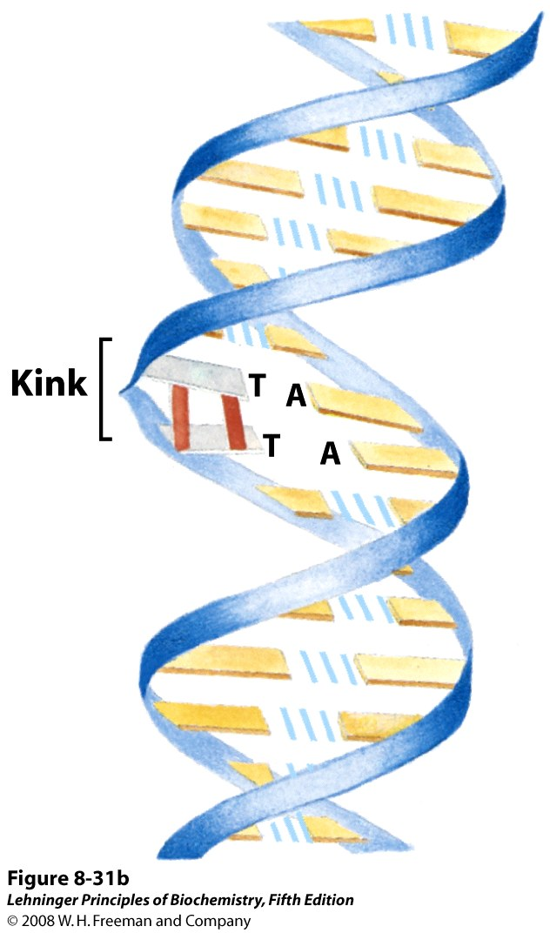
DNA damage in response to UV radiation

Slide 14
Nucleotide excision repair

Slide 15
Direct repair of DNA damage
DNA repair by photolyase
Removal of methyl group
Notes:
s-adenosyl methionine

